Slide 1
Initial Workshop for Bank of Portugal

Slide 2
Agenda
Current situation
Problem definition
Proposed Solution

Slide 3
Current Situation and Gap
Campaigns are running frequently
Data is gathered from those campaigns
Demographic of the customers
Duration & frequency of calls with customers
Success of campaign on customers
Campaigning for products is done the same way for all clients
Outcome is not ensured
Notes:
As of now
the campaigns are running frequently
They are gahtering the data from them
Not using the data
Each campaign is run the same way
Towards all clients and with the same aproach towards all of them

Slide 4
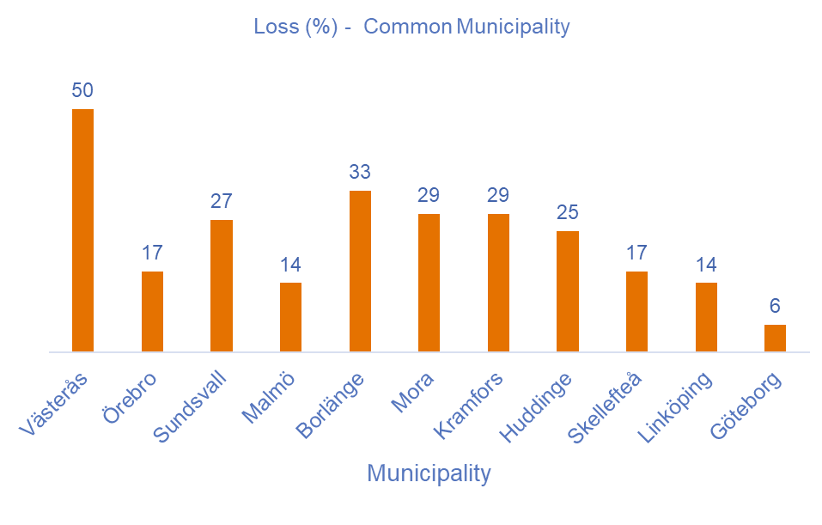
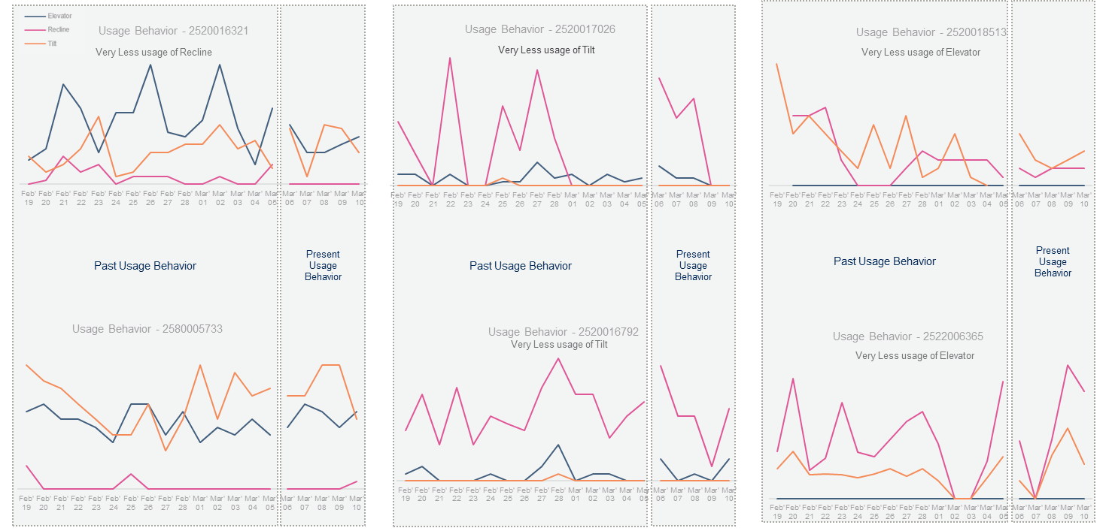
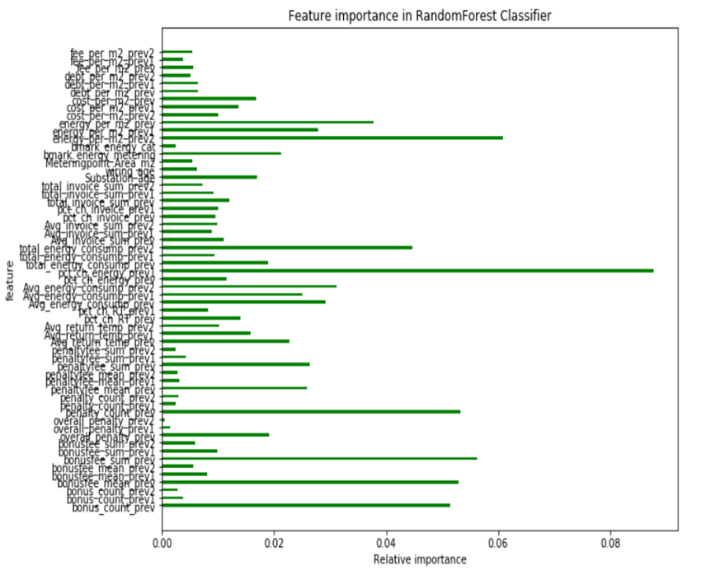
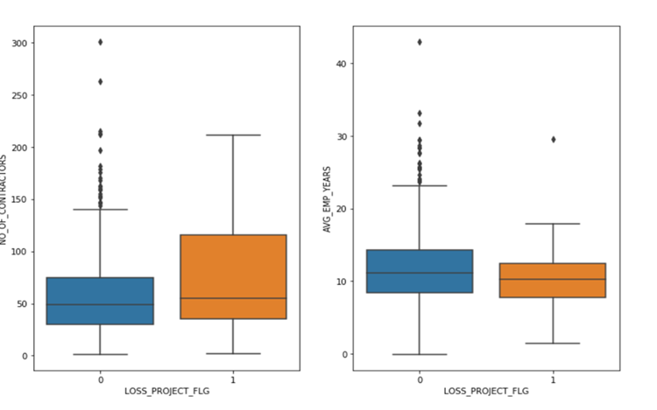
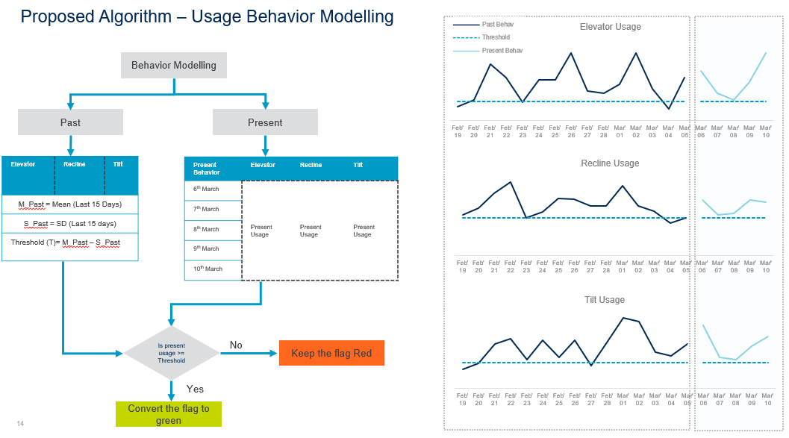
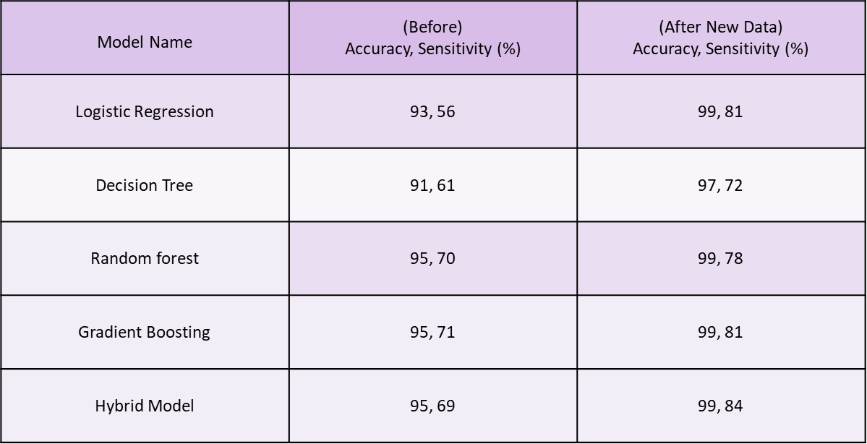
Value examples from advanced analysis
Project Profitability
Analysis
Predictive Maintenance
Analysis
Churn Prevention
Analysis
Deviation between successful and non-successful projects are used for modeling purposes.
Features like combinations of alarms and usage behavior are used to predict which vehicles to prioritize for service.
Machine Learning algorithms used to predict B2B churn risk behavior and create targeted marketing activities.
Notes:
This is what we have done in the past for clients
Cecking which of the projects will be successfull

Slide 5
Getting started with Advanced Analytics
 | Phase 1 – week 1 |  | Phase 2 - week 2-3 | Phase 3 - week 4
Activities | Secure business use case and data Agile analytics workshop 1.1 Use case definition and prioritization with stakeholders. 1.2 Define the minimum viable product 1.3 Select relevant KPIs/Metrics/Outcome for use case. 1.4 Define cross-functional team structure. 1.5 Define roles and responsibilities in team. Select & deliver data 1.6 Define technology to be used for MVP. 1.7 Secure access to analytics platform 1.8 Select data sets required for MVP 1.9 Deliver data for MVP |  | Data Analytics Develop Data & Analytics 2.1 Prepare data for analytics 2.2 Data exploration 2.3 Data feature analysis 2.4 First iteration: Pattern recognition and model development 2.5 Workshop to review analytics findings 2.6 Second iteration: Pattern refinement based on workshop | Present the MVP Deliver Analytics Insights 3.1 Documentation of findings. 3.2 Stakeholder presentation of MVP. 3.3 Present next steps.
Deliverables | Multidisciplinary team structure and roles and responsibilities. Relevant KPIs/Metrics/Outcome for the use case. Data to be used in MVP. |  | Data profiling findings Analytics feature data set Initial ideas based on data analysis | MVP package Data Science methodology used in MVP Presentation with outcome and recommended next steps
Setup environment for MVP
Wait for data

Slide 6
We have these capabilities

Slide 7
This is what we can do for them starting with this case
Create a Next Best Offer solution for all marketing campaigns going forward
Case: use the currect campaign to produce the model.

